Slide 1
FROM GARBAGE DUMP TO GREEN ENTRANCE: Clean & Neat 1st Gate Developed

Slide 2
FROM GARBAGE DUMP TO GREEN ENTRANCE: Clean & Neat 1st Gate Developed
BEFORE:
• Just inside the 1st Gate, front side area was full of garbage
• Everyone was throwing waste there, entrance looked very dirty and ugly.
• Syntax water was continuously leaking and flowing wastefully.
AFTER - DEVELOPMENT BY SECURITY TEAM:
• Entire area cleaned thoroughly with help of Housekeeping team.
• Kabali plants (ornamental plants) planted for beautification.
• Now entrance looks neat, clean and beautiful.
• Leaking Syntax water is now effectively utilized for plants - No wastage.
• Area systematically organized for Car Parking and Two-Wheeler Parking.
RESULT:
A Dirty Garbage Point is Now a Clean, Green & Organized Entrance.

Slide 3
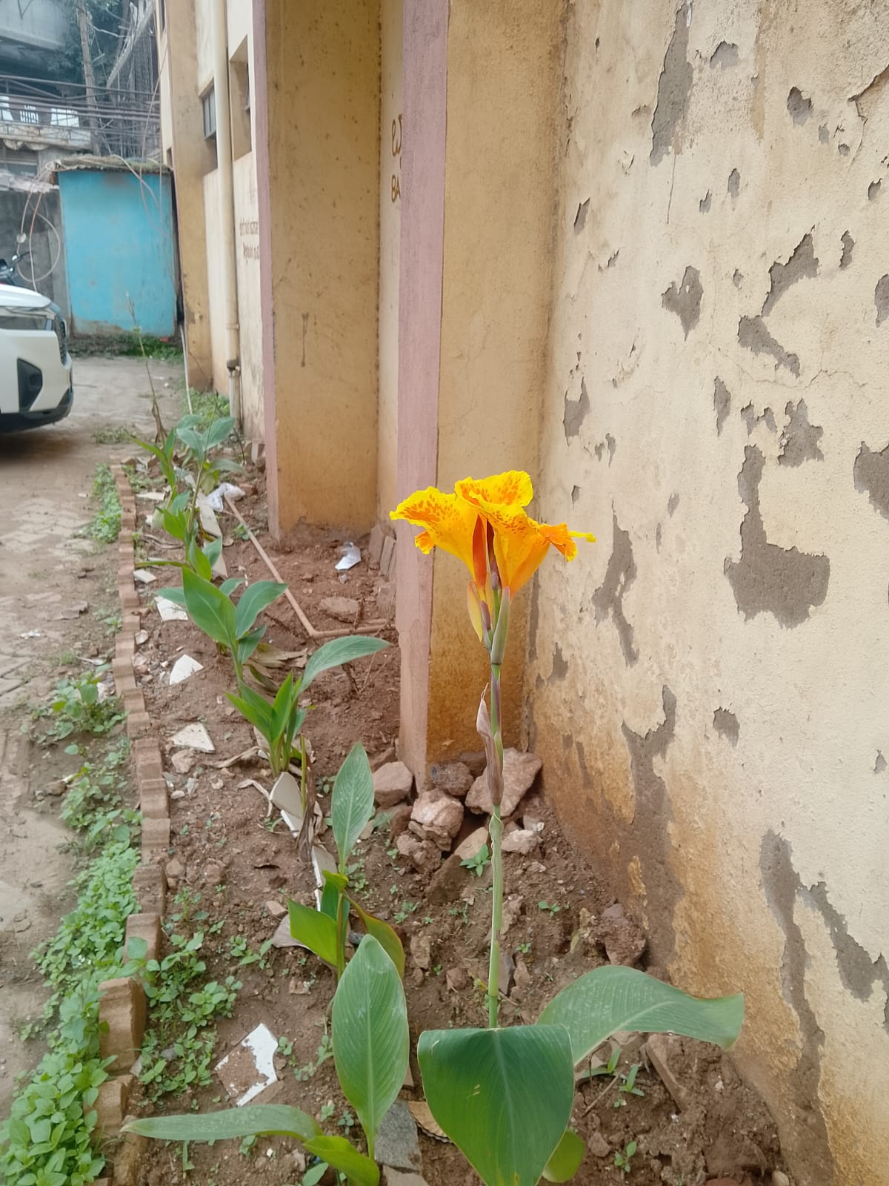
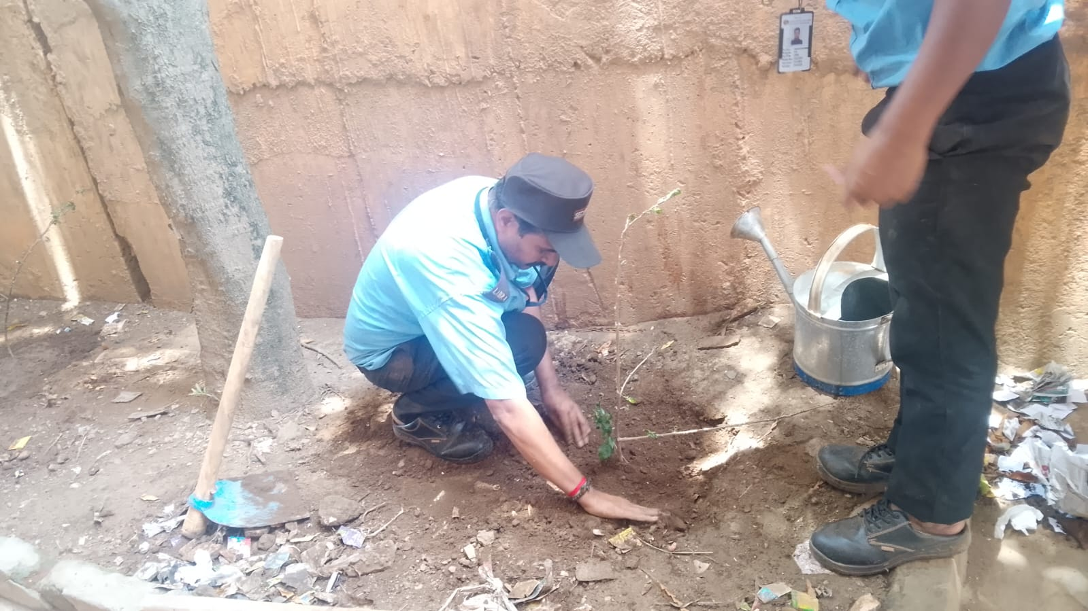
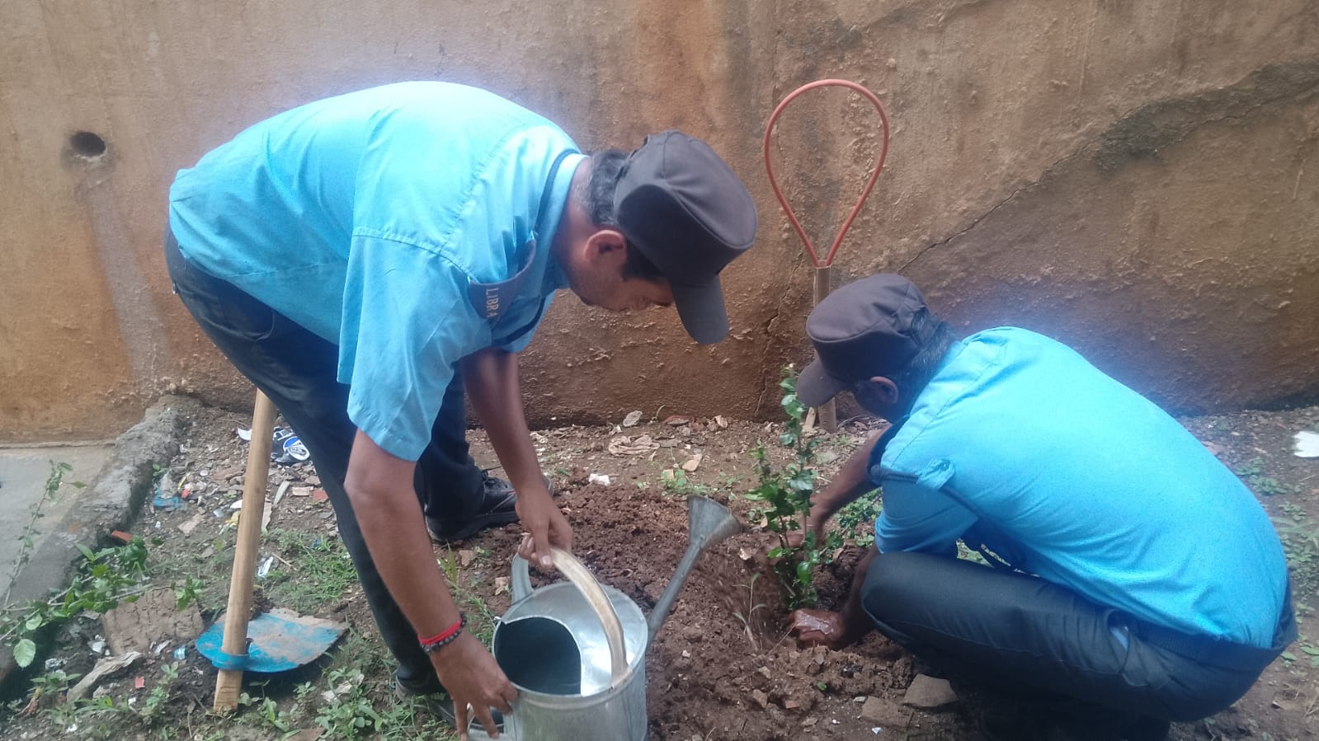
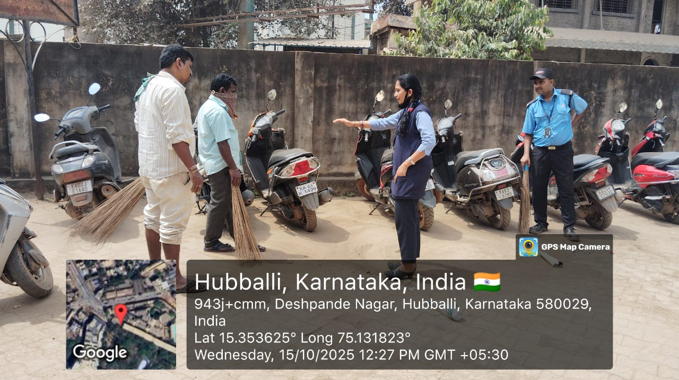

Slide 4
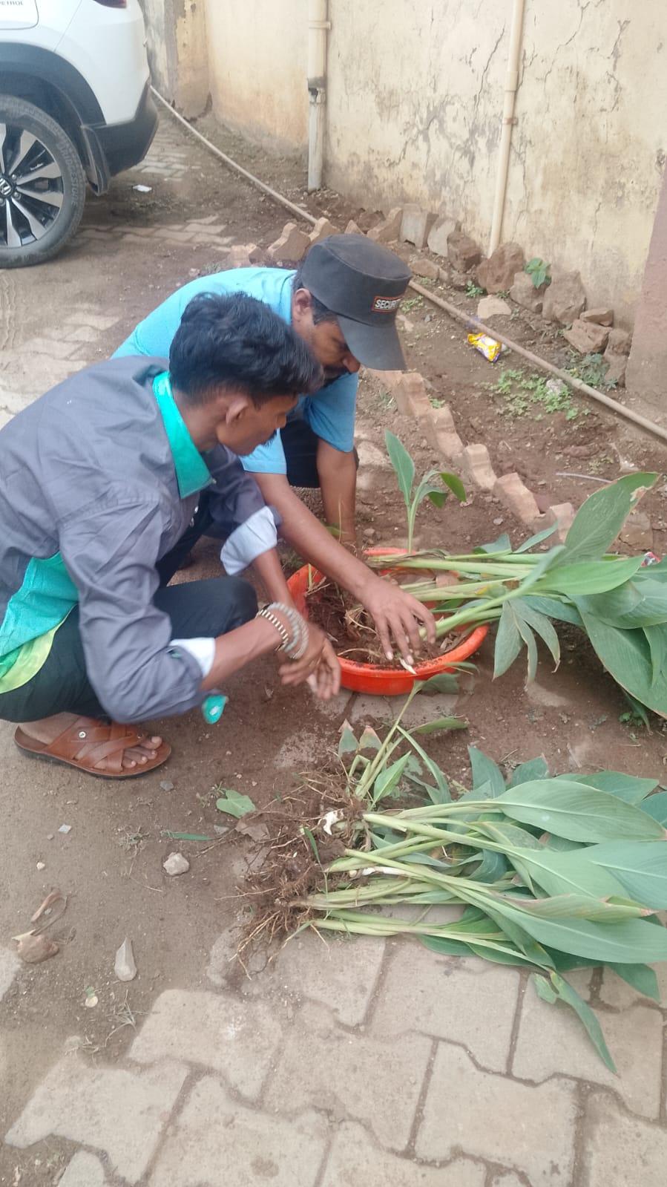
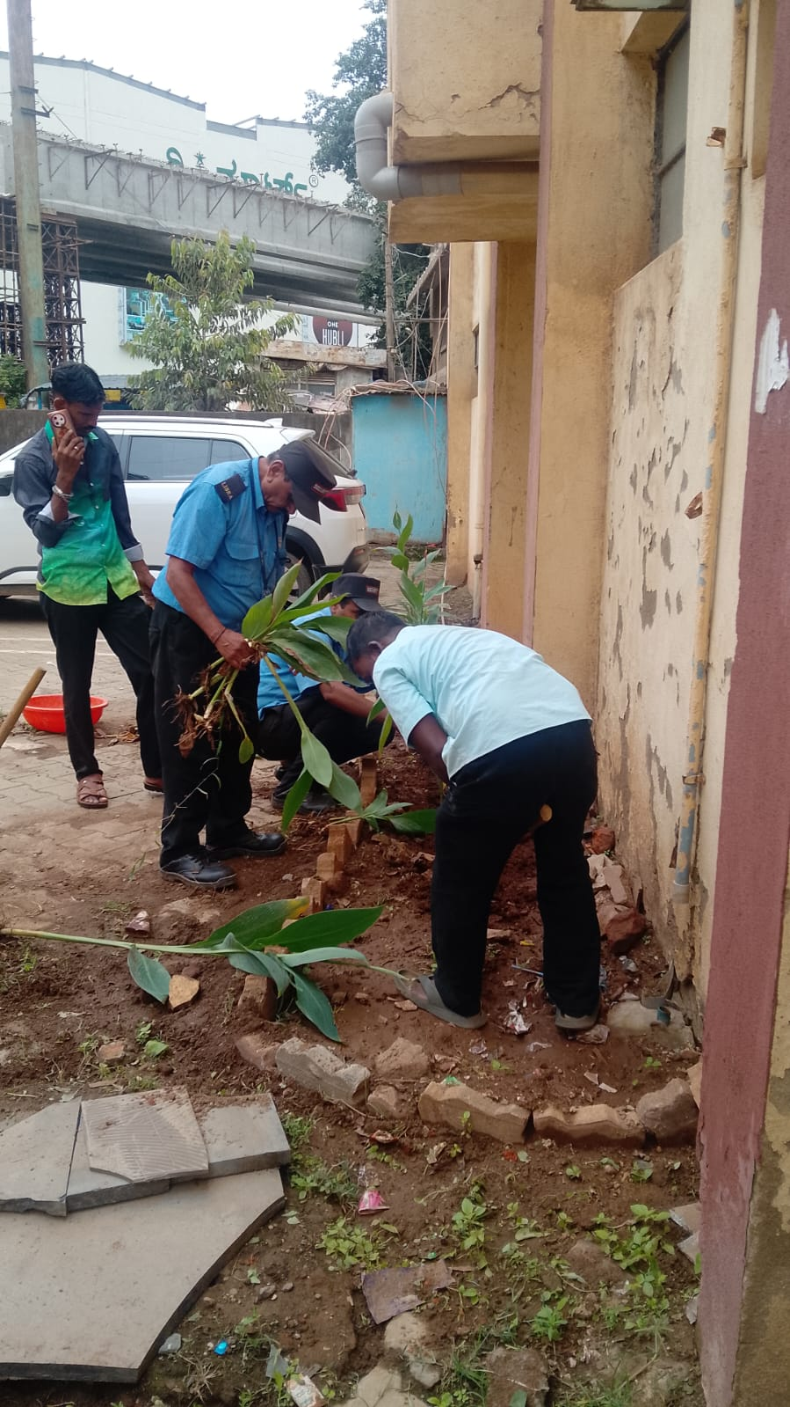
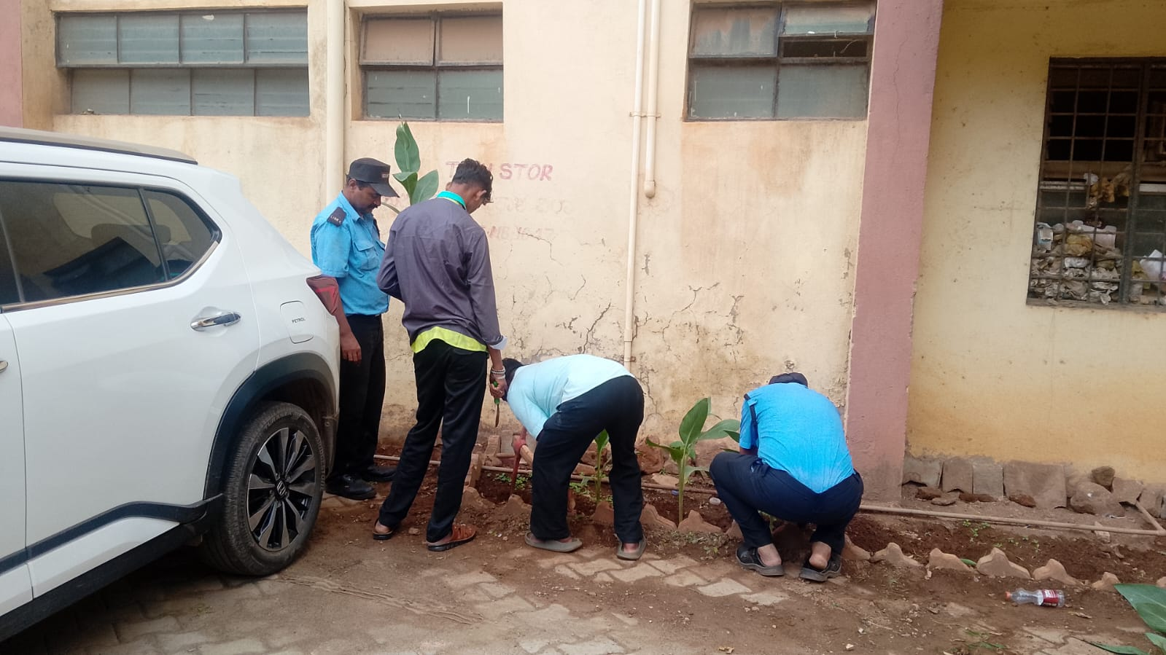

Slide 5
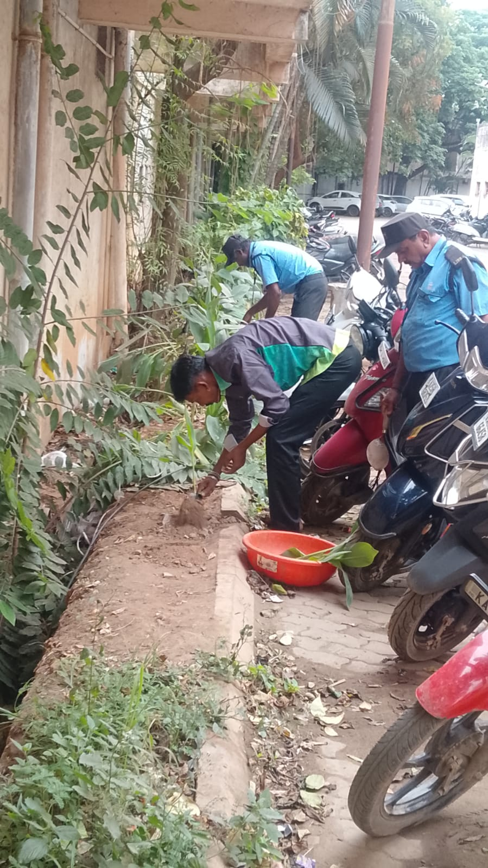
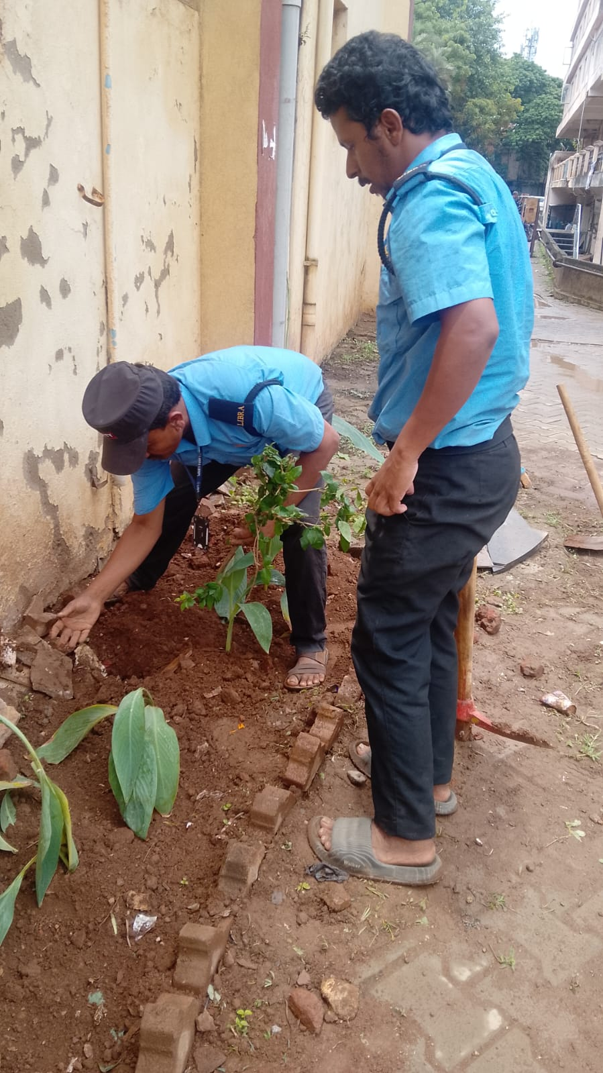
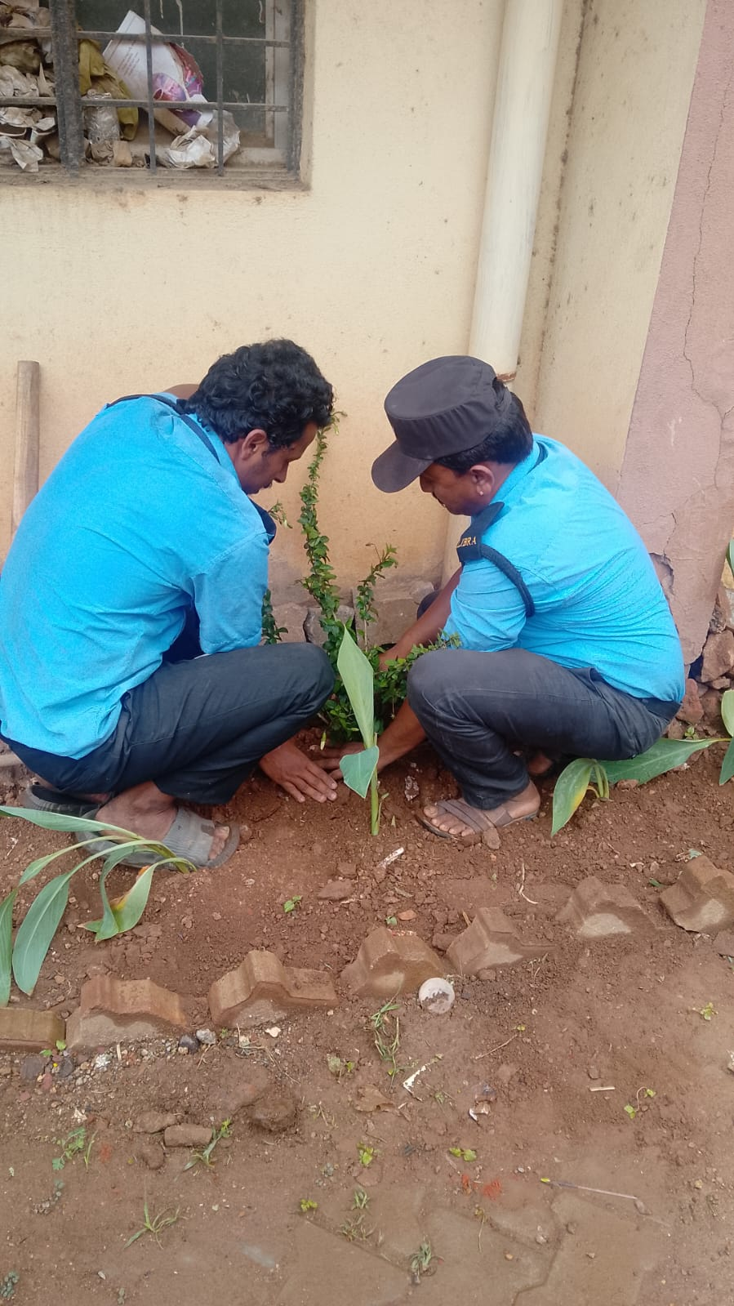
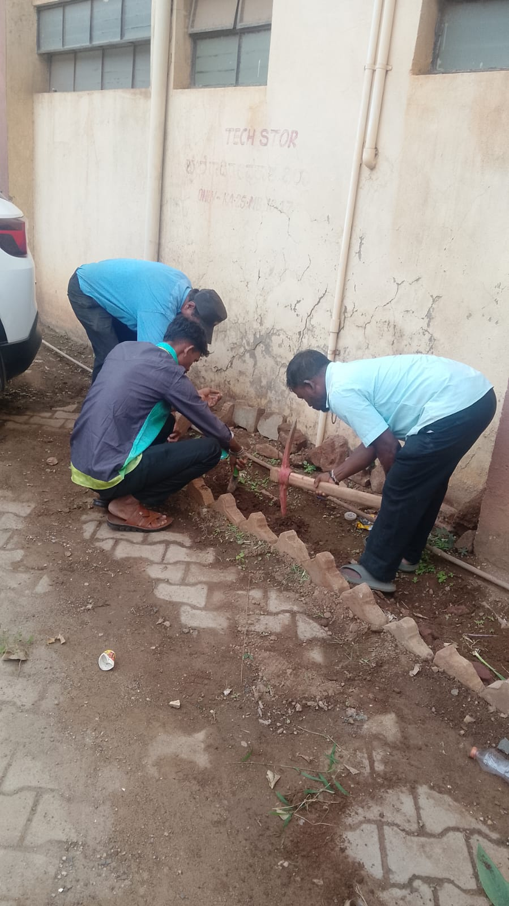

Slide 6
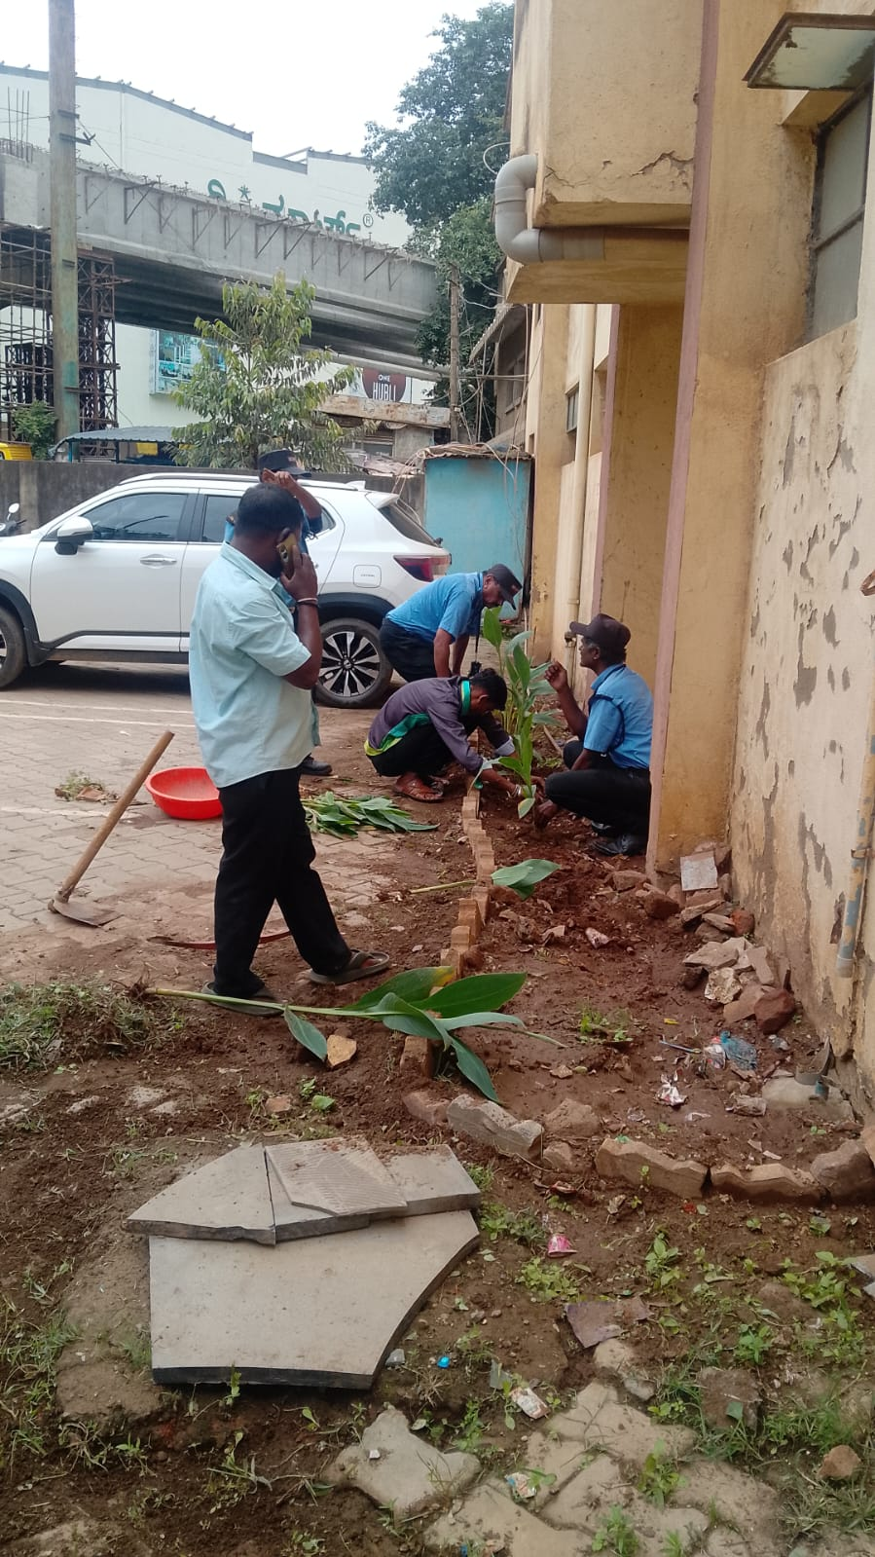
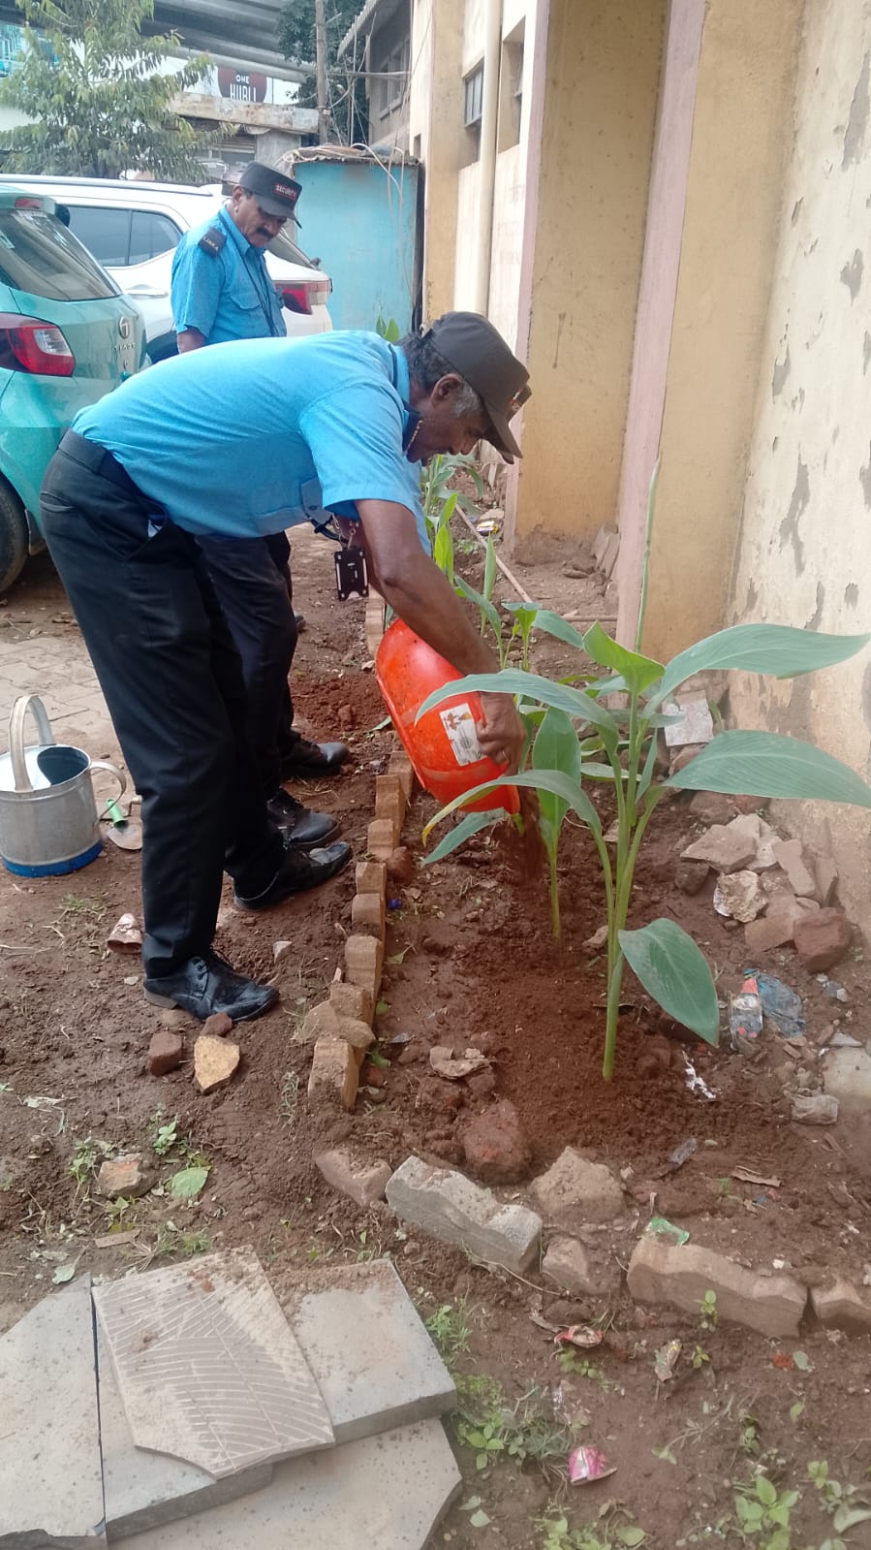
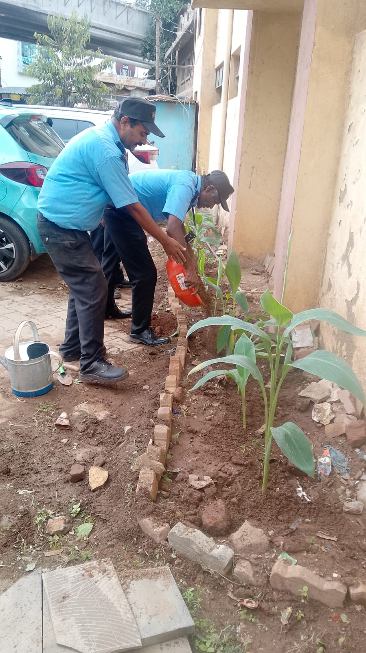
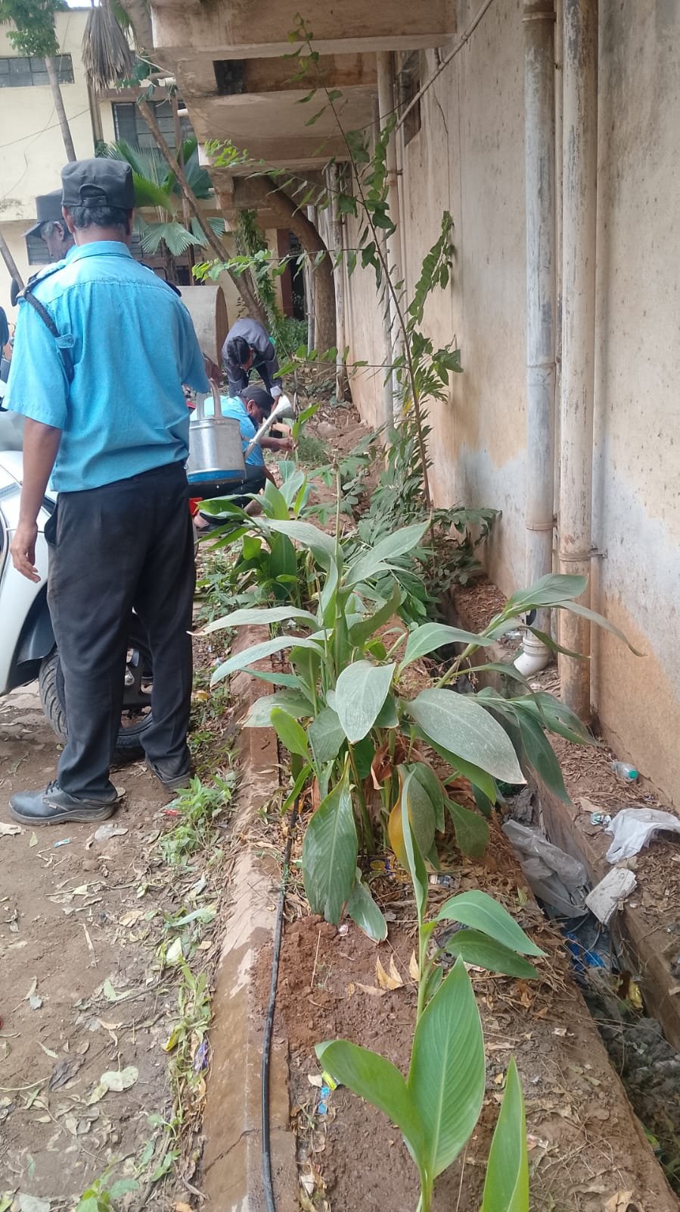

Slide 7
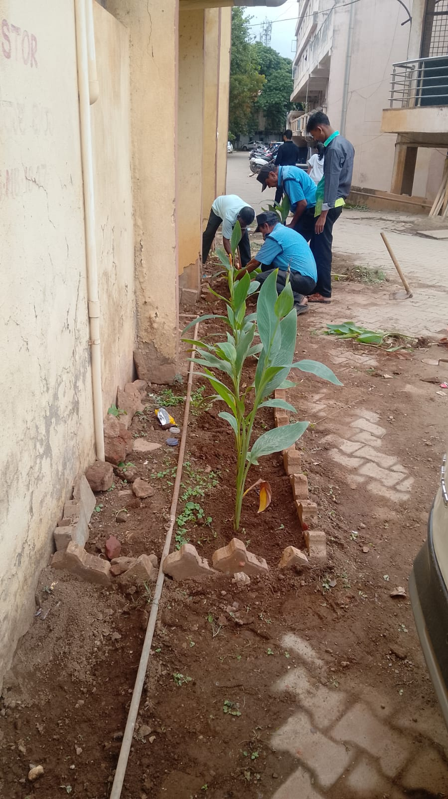
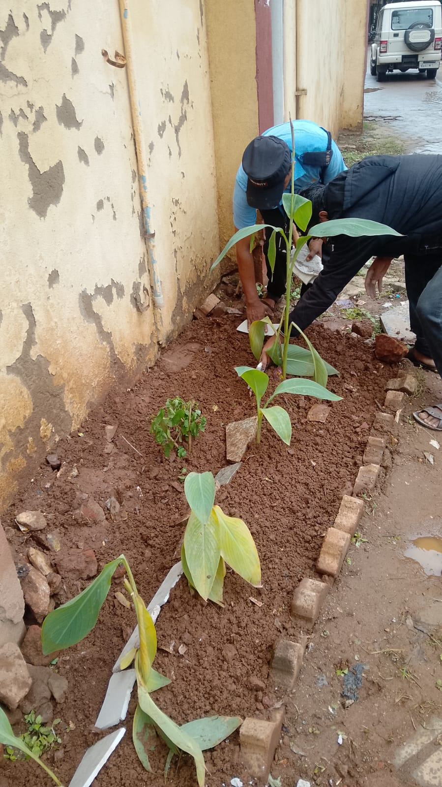
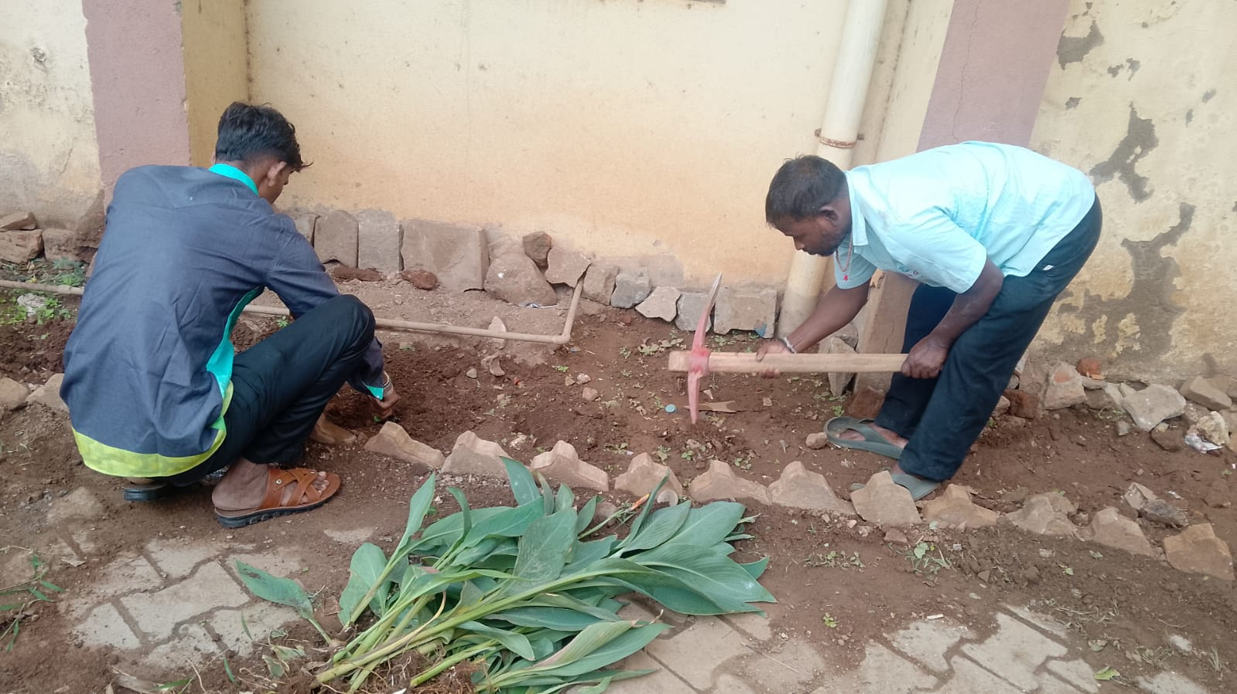

Slide 8
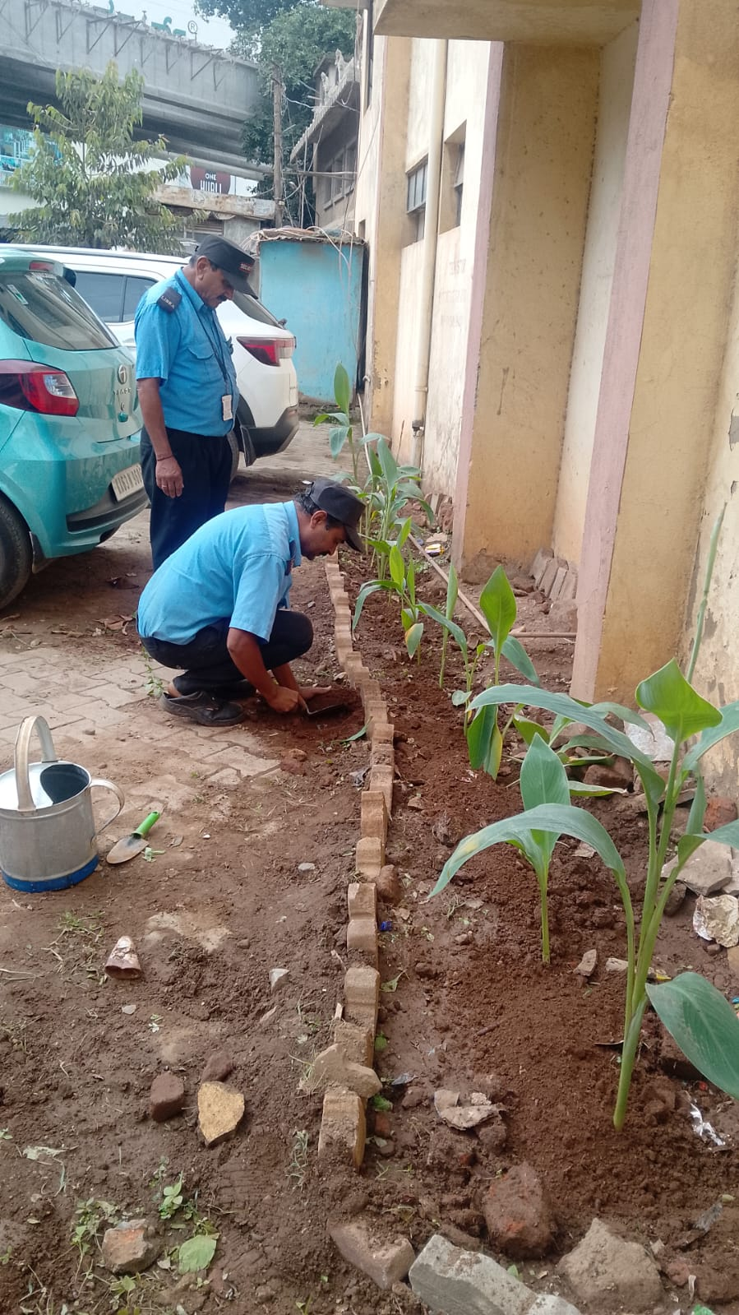
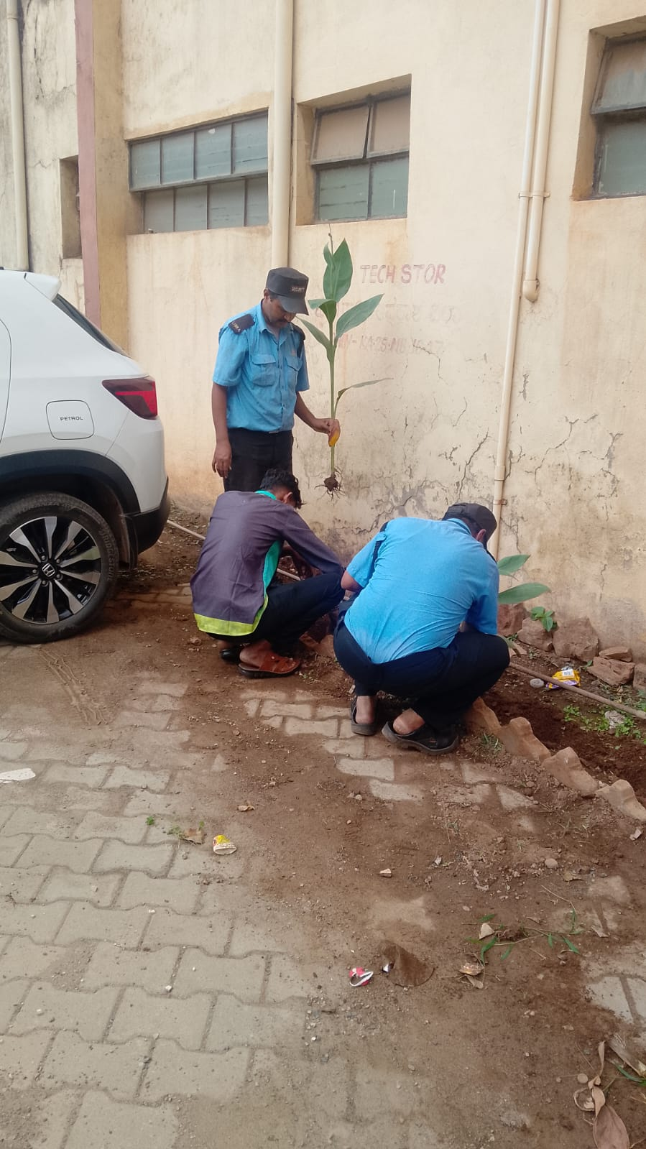
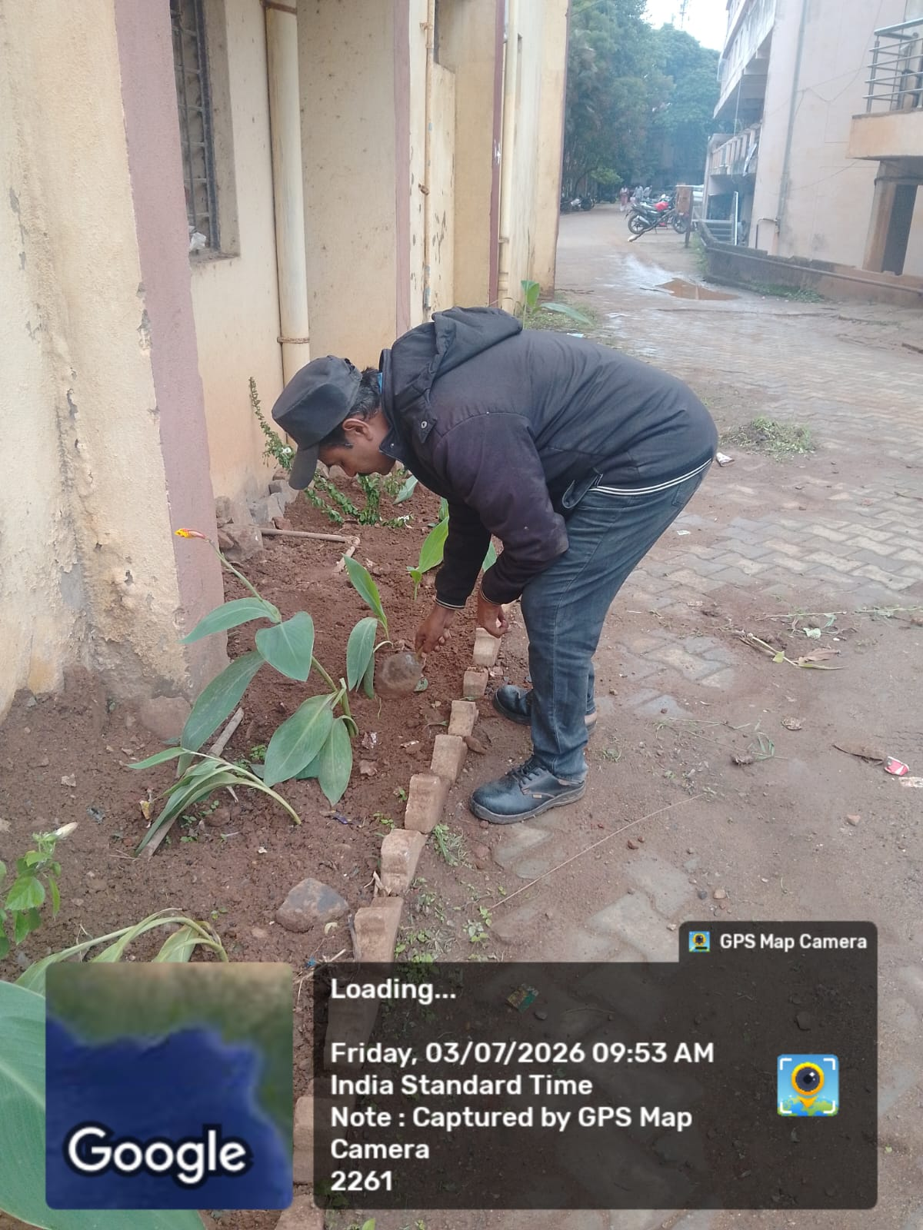
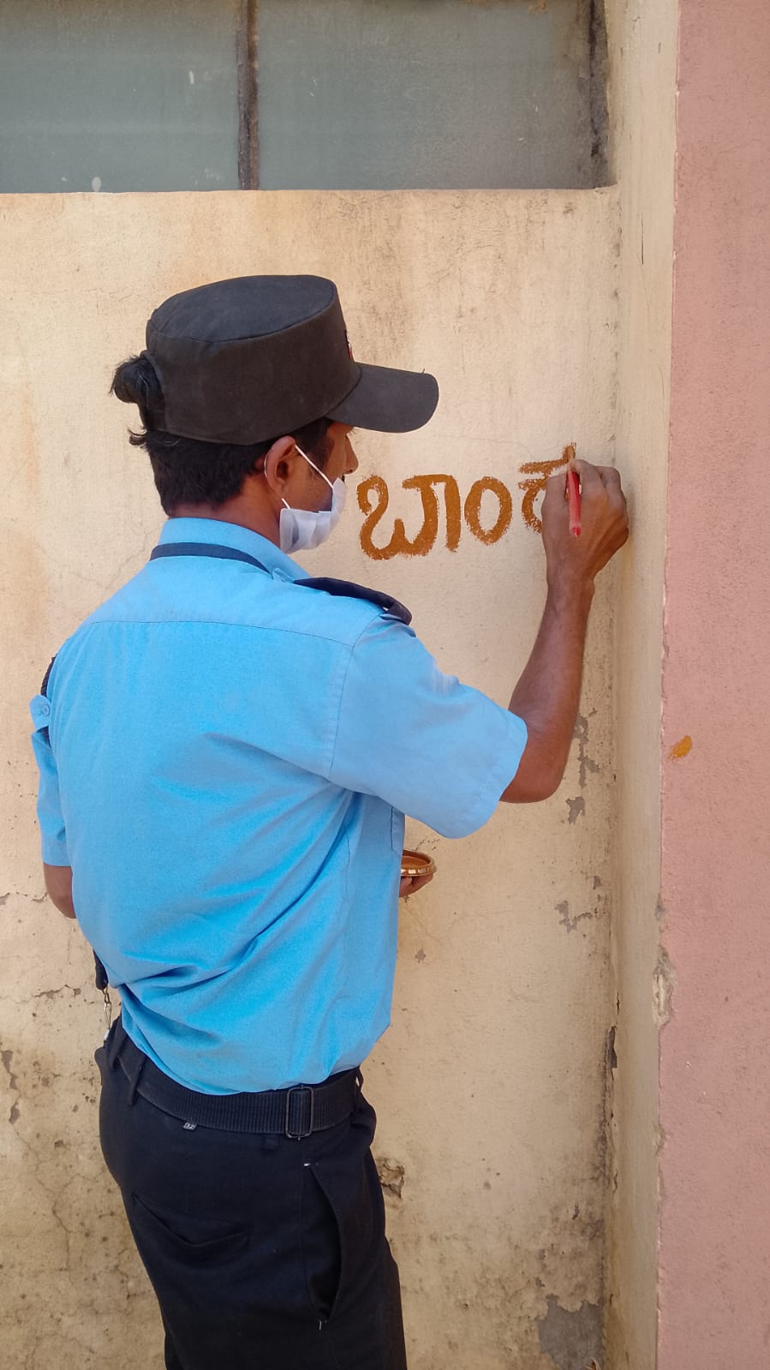

Slide 9
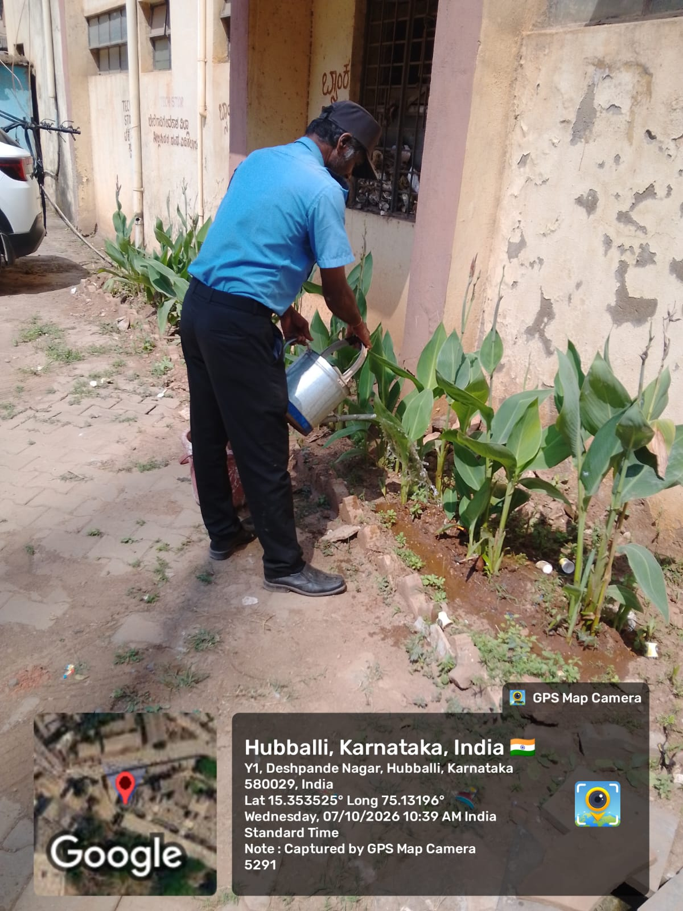
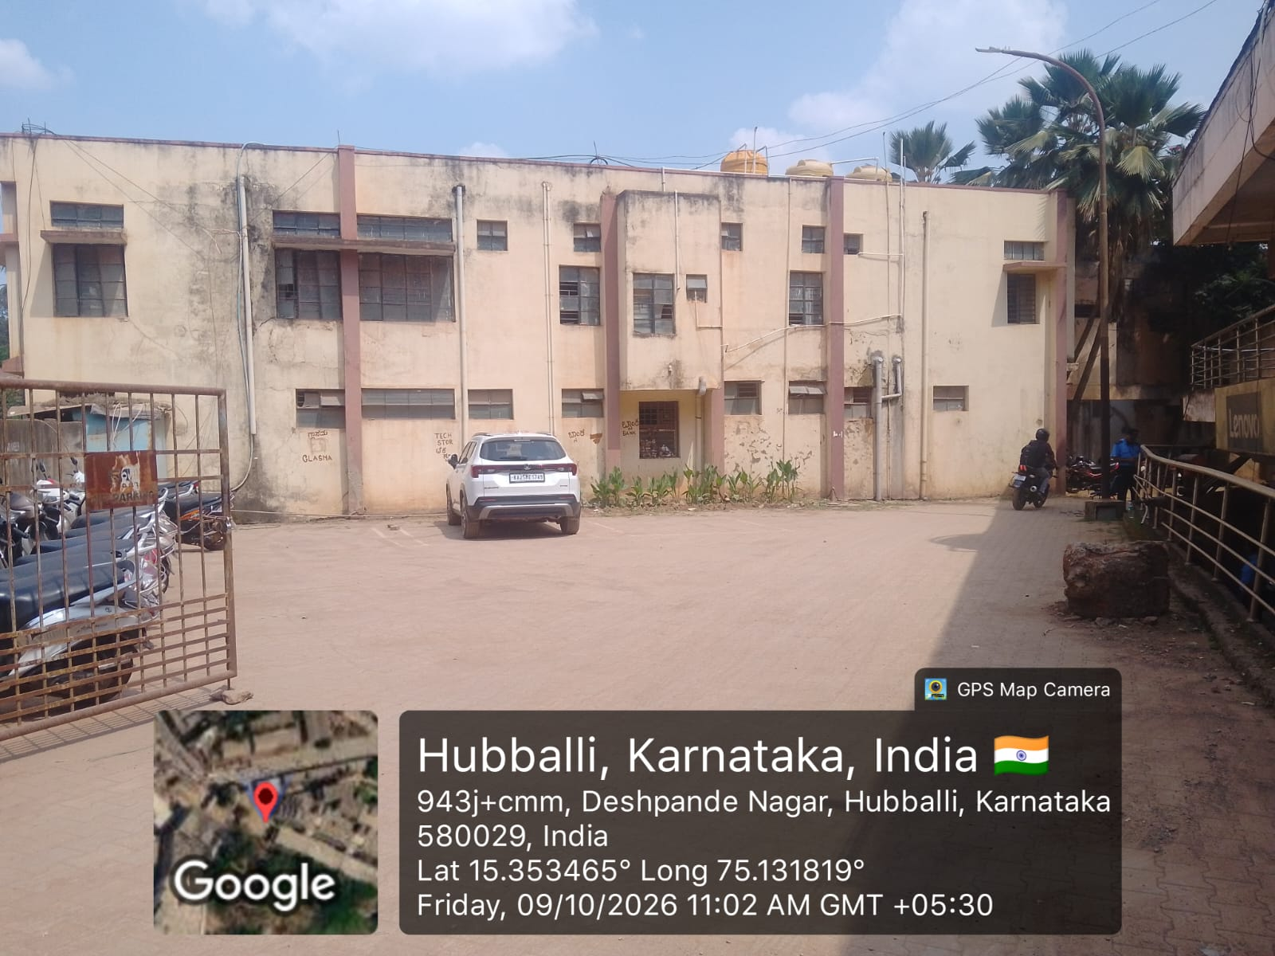
FINAL OUTCOME - 1st GATE ENTRANCE
* 1st Gate Entrance area has been beautified and cleaned.
* Organized Two Wheeler and Car Parking arrangement has been completed.
* Parking area is now clear, systematic and under regular observation.

Slide 10
THANK YOU FOR WATCHING

